Slide 1

Why Is Technology Failing Us?
Webinar • July 26, 2017

Slide 2
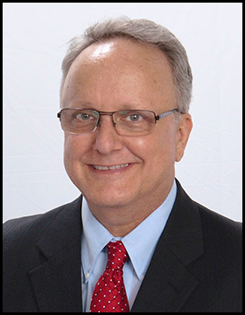
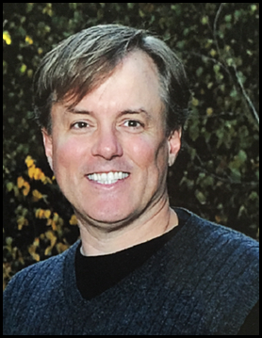



Your Speakers
Richard Spies
President & CEO,
LucidIQ
Chuck Cole
Director of Client Engagement, LucidIQ
Tom O’Connor
Director, Gulf Coast Legal Tech Center
Notes:
Richard Spies
CEO and President, Lucid IQ
R.Spies@LucidIQ.com
Chuck Cole
Director, Client Engagement, Lucid IQ
C.Cole@LucidIQ.com
Tom O’Connor
Director, Gulf Coast Legal Tech Center
TOConnor@GulfLTC.org

Slide 3
• Altman Weil Survey
• Our Experience
• Your Experience
• Simple Is Hard!
• Solutions
• Going Forward
Agenda
Notes:
Altman Weil’s law Firms in Transition, 2017; Sets our point of reference
Our Experience; What we see as consultants in law firms and an overview case study
Your Experience; Real perspective from the real world.
4. Simple Is Hard. Why? Complexity, Implementation and Change are all Hard!
5. Solutions
People and Process Not Technology
Lawyer Not The Laptop
6. Going Forward

Slide 4
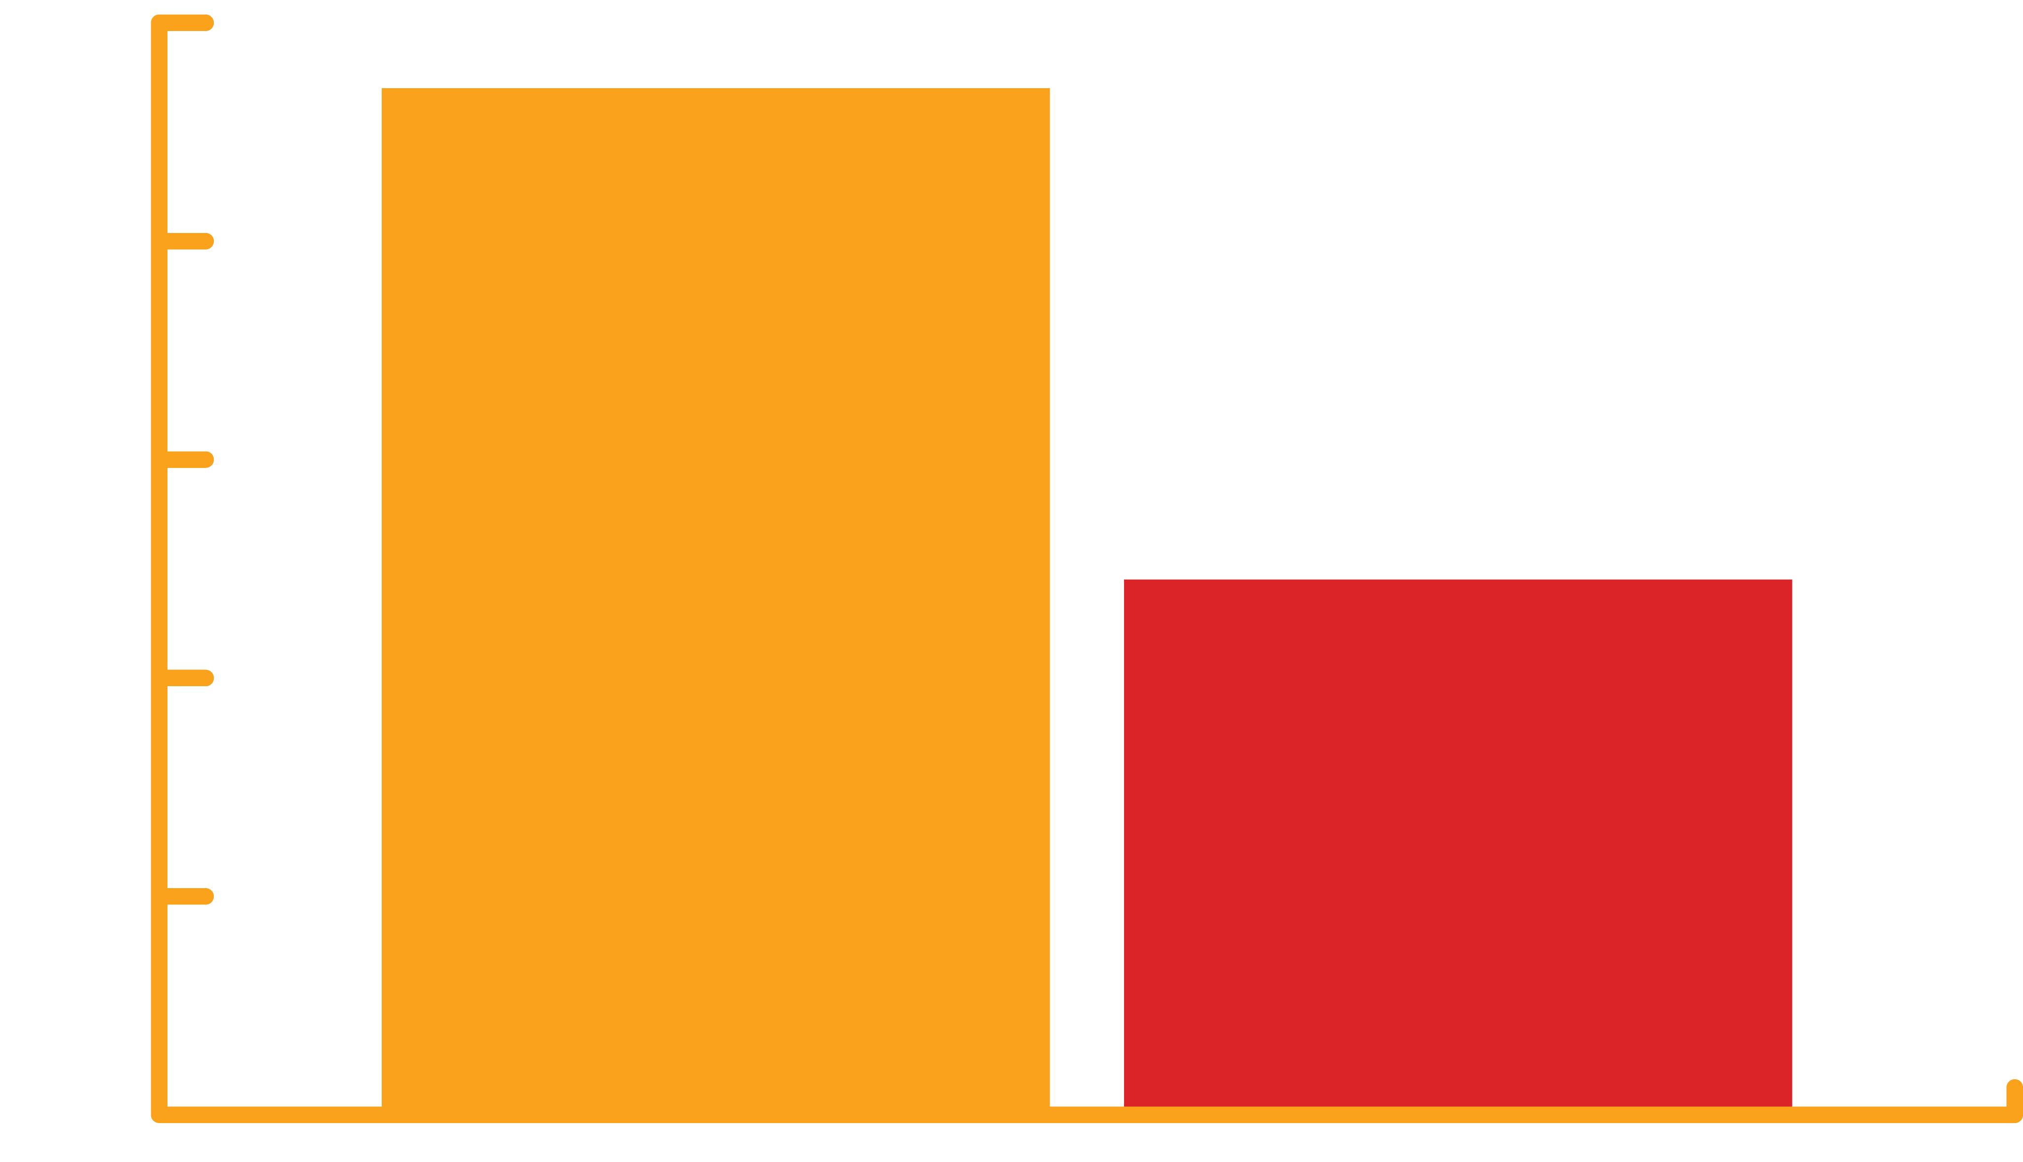
Law Firms in Transition 2017
An Altman Weil Flash Survey
“Focus on improved
efficiency will be a
permanent trend…”
94%
believe it
49%
address it
altmanweil.com/LFiT2017
Notes:
Chronic under-performance: 88% of firms say they have chronically under-performing lawyers, 52% and 61% of equity partners and non-equity partners, respectively, aren’t busy enough. Overcapacity dilutes profitability in 61%.
The levers of profitability: Cutting office space, under-performing lawyers, excess staff, and low margin practices and offices are yielding immediate bottom-line results. Lateral acquisitions and investments in business development, while widely pursued, are less effective drivers of profitability at least in the short-term.
Linking pricing and efficiency: Only 30% of law firms routinely link discounted, capped and alternative fees to changes in how work is staffed and delivered – a critical misunderstanding of the interdependence of their business model elements, which include scope, staffing, price, work flows, project management and margin.
Innovative experiments: 50% of law firms report they are actively engaged in experiments to test innovative ideas and methods. These initiatives run the gamut from technology and data analytics to new business ventures, efficiency, pricing and staffing improvements, and efforts aimed directly at client engagement and retention.
The problem of partner resistance: 65% of law firm leaders say their partners resist most change efforts, and 56% say most partners are unaware of what they might do differently. This reluctance to change is an intractable problem in many law firms.

Slide 5

Our Experience
Notes:
Current Situation Facing Firms and Organizations
- Need for consistent and growing profits
- Increasing competition and client expectations
- Need for tools to deliver more for less
Vendors’ ROI Promise
Invest in and implement technology
Increase efficiency, quality and customer services
Compete and win more profitable clients
Win-Win-Win! Technology’s ROI Promise for All!
The client wins!
The firm wins!
The vendor wins!
This isn’t how it typically works out.
A Typical Story – Need for Technology
Typical Pain → Need to do more with less
Typical Implementation → Features and functionality for all
Typical Results → Minimum usage, frustrated stakeholders, no net ROI

Slide 6

Your Experience
Notes:
Two real-world stories from real people.
Jeff Parkhurst. Former New York AG’s office on implementing technology in national case with dozens of other state AG offices
Toby Brown, Chief Practice Management Officer at Perkins-Coie. The real cost of software implementation with firm clients

Slide 7

Why?
Simple is Hard.
Notes:
The Big Why’s
Business is complex → Simple is Hard!
Technology is complex → Implementation is Hard!
People are complex → Change is Hard!

Slide 8

Solutions:
People and Their Priorities
Notes:
People, People, People (Chuck)
Focus on people and their priorities in their work process → Simplify the Complex
Focus on bite-size projects not one-size-fits-all projects → Simplify the Technology
Focus on user feedback early and often → Simplify the Change
Key Factors (Tom)
Workflow
Analysis
People
Training
Certifications

Slide 9

Going Forward
Notes:
Meet us at ILTA in booth 136
Second webinar in September
Contact us any time

Slide 10
Why is Technology Failing Us?
Webinar • July 26, 2017
Richard Spies
rspies@lucidiq.com
Chuck Cole
c.cole@lucidiq.com
Tom O’Connor
toconnor@gulftc.org

